Slide 1
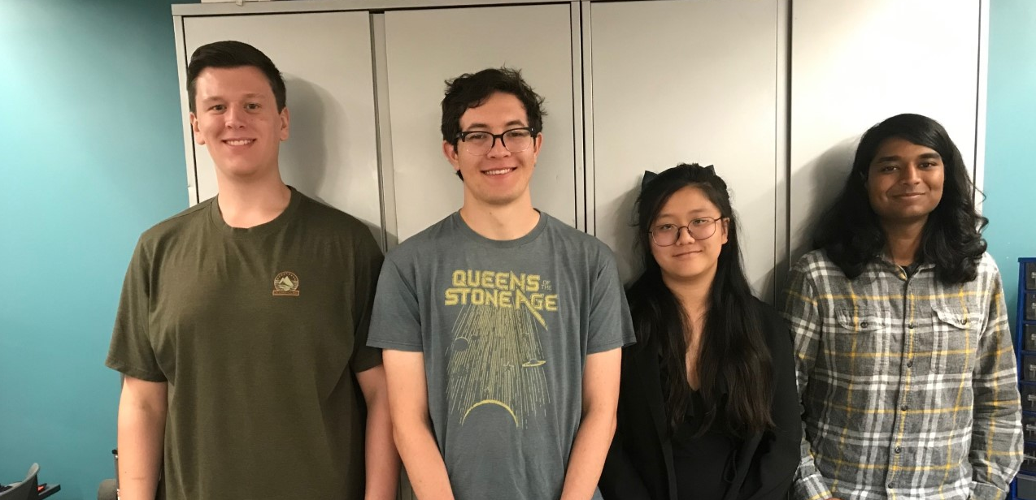
ECE477 Midterm Design Review: Team 3
<Add team picture or relevant project picture here>

Slide 2
Outline
Project Overview
Major Components
Block Diagram
Packaging Design
Electrical Schematic
PCB Layout
Prototyping Progress
Software Development Status
Project Timeline
Questions

Slide 3
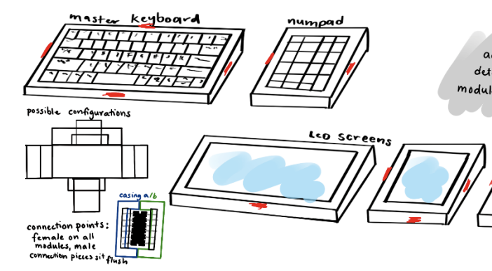
Project Overview
Not your average Keyboard (NYAKB)
NYAKB is a newcomer in the growing mechanical keyboard community that includes a high quality, phone sized LCD screen that will display various information, and can interact with the keyboard itself. The module will be detachable. Current keyboards on the market don't have the unique display functionality NYAKB has.

Slide 4
PSSCs
PSSC #1 (Hardware): An ability to have a key switch matrix for the various typing keys on a keyboard that can be scanned and debounced for clean inputs by the microcontroller on the main keyboard module.
PSSC #2 (Hardware): An ability to drive an LCD display via SPI.
PSSC #3 (Hardware): An ability to step down 5V USB input power to 3.3V for the main keyboard MCU and display module MCU/display.
PSSC #4 (Hardware): An ability to have the main keyboard MCU serve as master and communicate to submodule MCU as slave over I2C.
PSSC #5 (Hardware): An ability to communicate key presses from the user to the Host PC over a USB connection.

Slide 5
Major Components
SUBTITLE
Choose the major (electrical) components being utilized by your design. For each component, provide a brief description of what it is, relevant specifications, and what it will do. Examples of major components include the microcontroller, motors, wireless interfaces, power converters and regulators. Examples of relevant specifications include operating speed (uC), number of I/O (uC), stall current (motors), operating voltage, and expected current consumption

Slide 6
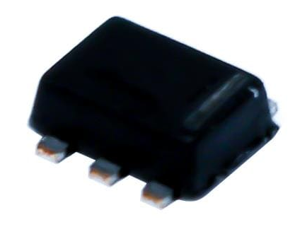
Major Components
Power Regulation
Buck Converter: TPS563231DRLT
Specs:
Input range 4.5V-17V
Output 3.3V
Max Current 3A
Usage:
This will be used to step down USB 5V input to 3.3V that will power the main keyboard (stm32f4) as well as submodules via the hot plug connection

Slide 7
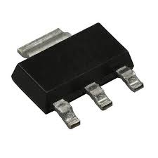
Major Components
Power Regulation
Voltage Regulator: LD1117S33TR_SOT223
Specs:
Input (Max) 15V
Output (Min/Fixed) 3.3V
Dropout 1.2V @ 800mA
Usage:
Built into the decoupling capacitor to step down the 5V input from the programming header on the peripheral device to 3.3V

Slide 8
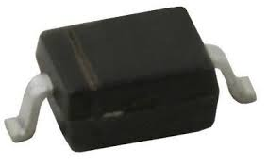
Major Components
Power Regulation
Voltage Regulator: BAT60JFILM
Specs:
Schottky Diode
DC Reverse Vr (Max) 10V
Forward Vf (Max) 580mV @ 1A
Usage:
Drop 3.3V to 3V0 for the SPI LCD display

Slide 9
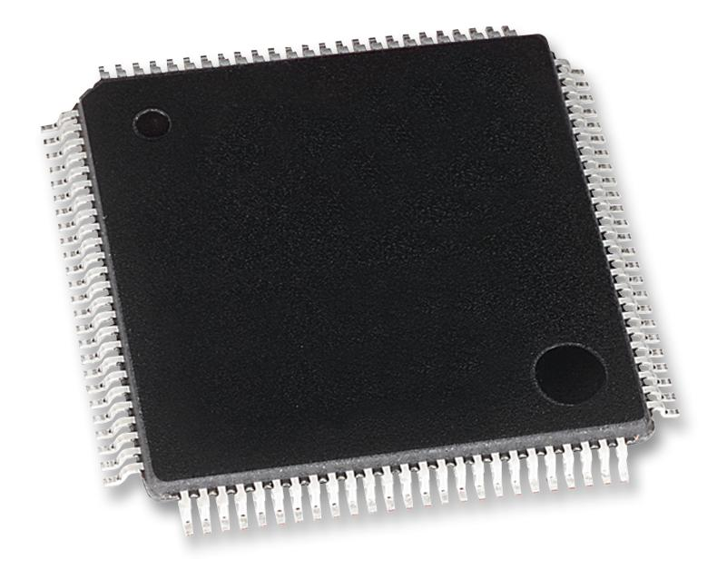
Major Components
Microcontrollers
Main Keyboard MCU: STM32F407VGT6
Specs:
USB FS Controller
I2C hardware blocks
GPIO
Usage:
This MCU will be used to communicate with the host PC over USB and to submodules over I2C. It will also scan the key matrix using GPIO
Power Consumption:
Max: 240mA @ 3.3V

Slide 10
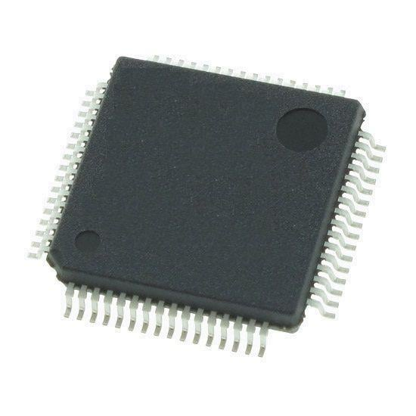
Major Components
Microcontrollers
Main Keyboard MCU: STM32F091RCT6
Specs:
I2C hardware blocks
SPI hardware blocks
Usage:
This MCU will be used to communicate with the SPI TFT LCD display to render info and to the main keyboard over I2C over the hot plug connector.
Power Consumption:
Max: 120mA @ 3.3V

Slide 11
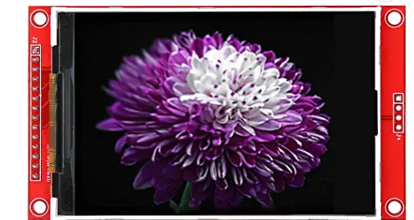
Major Components
Display
Display: MSP3520
Specs:
3.5" TFT display module
320x480px resolution
Usage:
Controlled over SPI
Present visual information to user
Power Consumption:
Approx. 84mA @ 3.0V

Slide 12
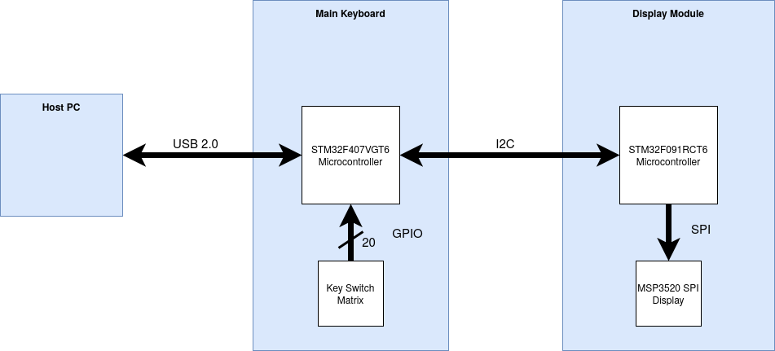
Block Diagram

Slide 13
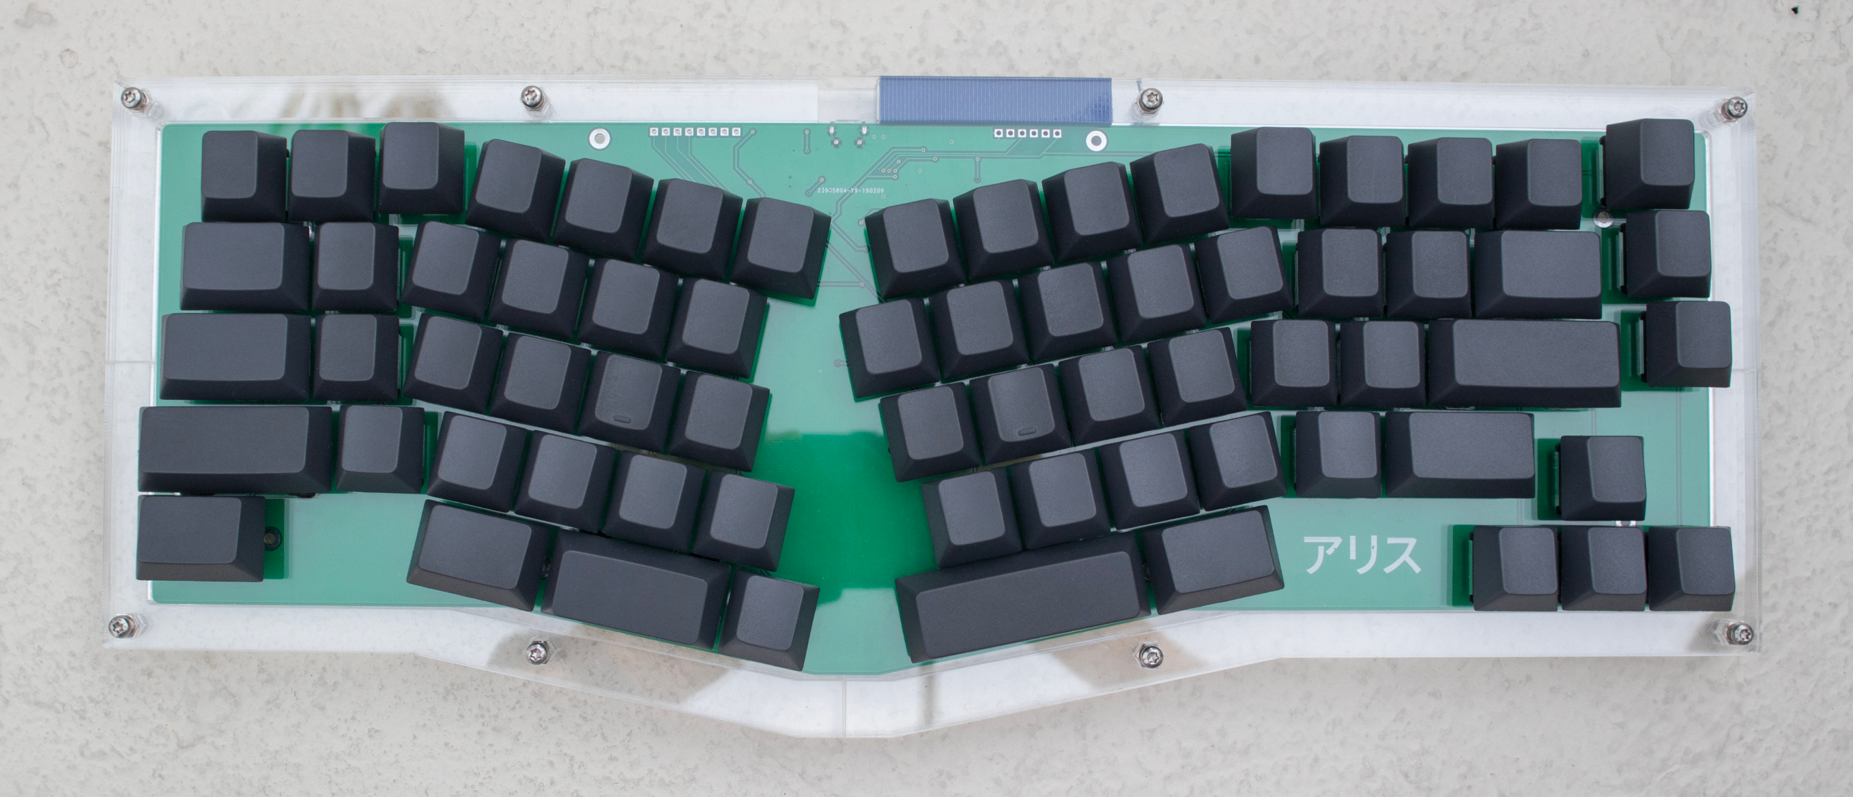
Packaging Design
Changes to our Packaging
We've opted for a new layout, so we've changed our packaging plans as well.
We'll be sandwiching the PCB between laser cut acrylic plates, and mounting them with screws.
Dimensions:
365mm x 142mm

Slide 14
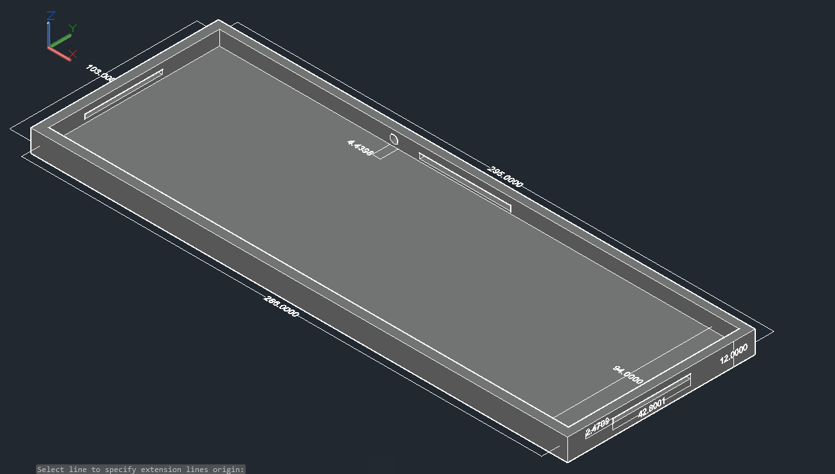
Packaging Design
Main Keyboard Original Design
Outer layer 295x103x12 mm
Inner layer 286x94x8 mm
3 access points to allow it to connect to other modules, and a point of access to connect to the USB port.
We will be using acrylic to create the packaging
Keyboard design has evolved

Slide 15
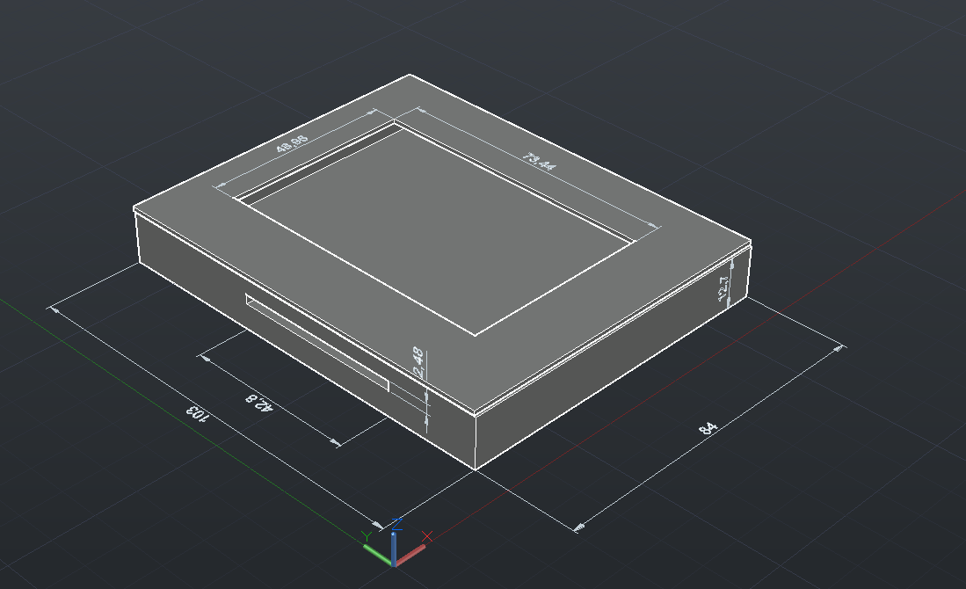
Packaging Design
Peripheral Original Design
Outer layer 83x103x12 mm
Inner layer 72x94x8 mm
Access point located on the left side of the device
Opening left for the LCD display to be seen
Plan to match materials with main keyboard by using the same acrylic
Keyboard design has evolved

Slide 16
Electrical Schematic
Include one or more views of your electrical schematic here. If necessary, break up this section into multiple slides detailing various subsystems which are easily viewable (Hint: a zoomed out view of a large electrical schematic in which nothing can be read will not be helpful for the design review). Your schematics should be complete, organized, and readable.

Slide 17
PCB Layout
Include one or more views of your PCB Layout here. If necessary, break up this section into multiple slides detailing various subsystems which are easily viewable (Hint: a zoomed out view of a large electrical schematic in which nothing can be read will not be helpful for the design review). Your layout should be complete, organized, and readable.

Slide 18
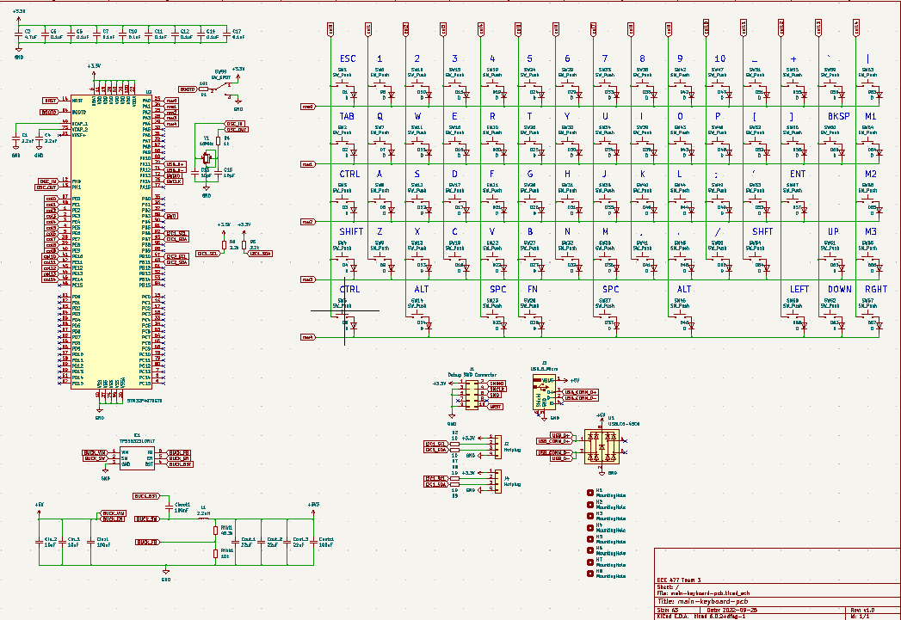
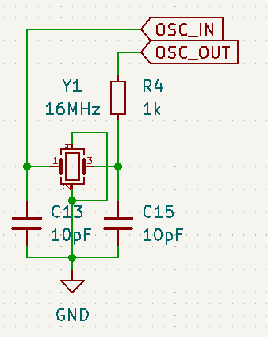
PCB Layout
Crystal Oscillator

Slide 19
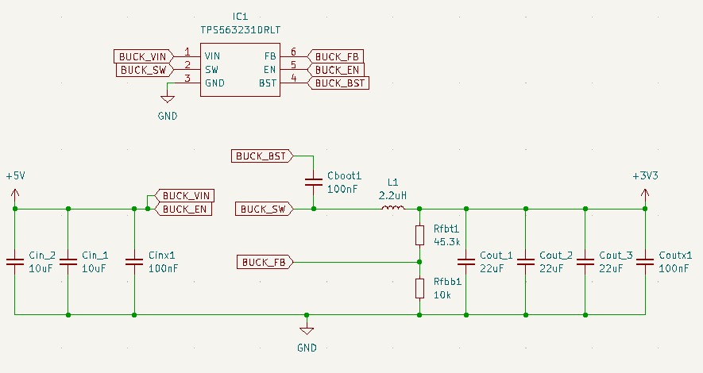
PCB Layout
Buck Converter

Slide 20
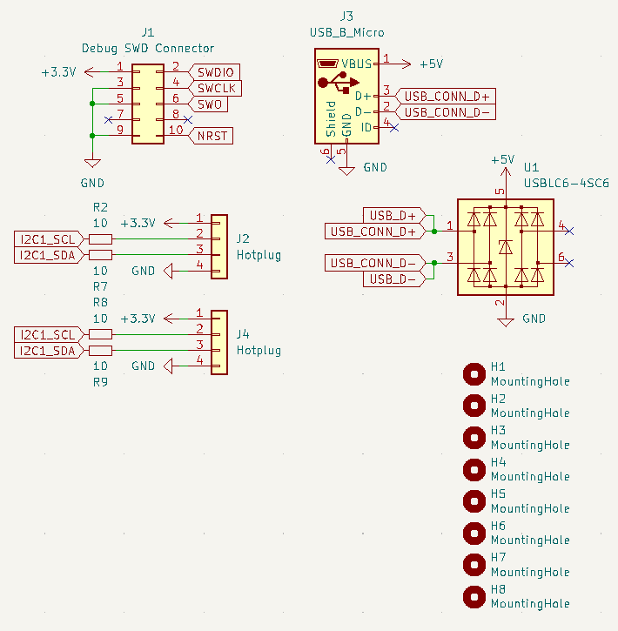
PCB Layout
Connectors

Slide 21
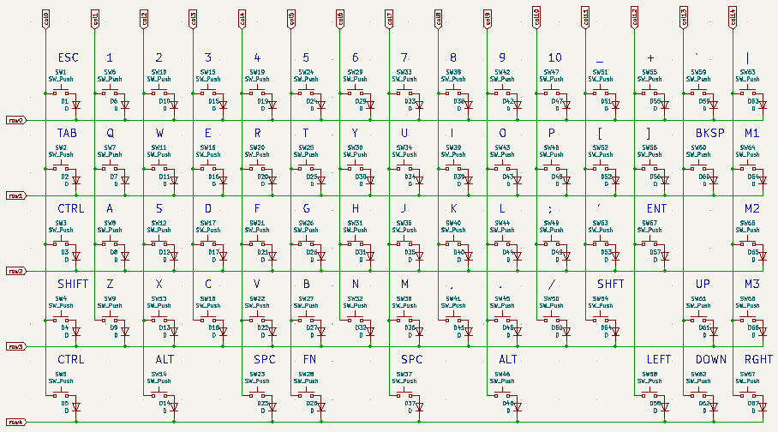
PCB Layout
KeySwitch Matrix

Slide 22
PCB Layout
Full View of Peripheral Design

Slide 23
PCB Layout
Peripheral Microcontroller

Slide 24
PCB Layout
Peripheral Programming Header

Slide 25
PCB Layout
Peripheral Programming Header Decoupling

Slide 26
PCB Layout
Peripheral Decoupling Capacitors

Slide 27
PCB Layout
Peripheral boot0 pull-down

Slide 28
PCB Layout
Peripheral LCD Sockets

Slide 29
PCB Layout
Peripheral Hot plug

Slide 30
Prototyping Progress
Prototyped buck convert made from discrete components
Opted to buy IC buck converter for use in our voltage regulator
Bi-directional communication between micro-controllers tested and proven functional
SPI display tested and proven functional
Key matrix scanning tested, need to verify that scaling to larger key counts
Implementing one possible software method of key debouncing
USB FS controller known to be capable of enumerating as HID
Need to test power draw capabilities

Slide 31
Software Development Status
Common software functionality
Task priority scheduling (In progress)
I2C module communication
Simple single byte bi-directional messages (Completed)
Multi-byte messages (In development)

Slide 32
Software Development Status
Main keyboard Software
Keyboard Scanning (In development)
Have smaller keypad without anti-ghosting diodes for prototyping, need to scale up to full key matrix upon PCB assembly
Key debouncing (In development)
Have one method, need to test with larger keyboard to verify performance.
HID enumeration as keyboard input device (Not yet started)
USB controller known to be functional based on part manufacturer demo code for HID mouse enumeration.

Slide 33
Software Development Status
Peripheral Module Software
SPI display
Minimally viable functionality complete
Utilization and integration with remainder of system in development

Slide 34
Project Timeline
Provide a timeline (or GANTT chart, etc.), starting from the current week until the end of the semester, detailing work to be undertaken in completing your team’s project.

Slide 35
3D Printing
Questions?

